Slide 1
Read write inc in fs2

Slide 2
Reading changes everything
Teach a child to read and keep that child reading and we will change everything.
And I mean everything.
Jeanette Winterson

Slide 3
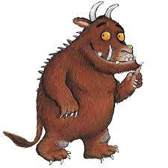
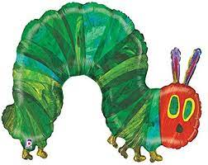
Read write inc phonics
New for FS2 children this term – new for the whole school in September
Children learning to read in FS2, Year 1 & Year 2
Taught in groups based on their stage of reading

Slide 4
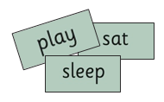
Daily phonic lessons
We teach sounds
Children practise reading words containing these sounds
We then give the children decodable books which contain sounds and words they can read

Slide 5
Tutoring
We want to make sure every child learns to read in our school.
Some children need extra practice when learning to read so we teach these children one-to-one for 5-10 minutes every day – on top of their group lesson.

Slide 6
What is phonics?
Sounds
Graphemes
44 sounds
26 letters
Over 150+ graphemes (letter combinations

Slide 7
Speed sounds set 1 and 2

Slide 8
Pure sounds

Slide 9
Sounds + blending = reading

Slide 10
Fred talk (blending)
Fred can only speak in sounds. He says d-o-g, h-a-t etc.
Speaking like Fred helps children to understand that words are made up of sounds.
Fred helps children practise blending sounds together because he needs the children to say the words for him. Fred says d-o-g, children tell him the word is dog.

Slide 11
Spelling using fred fingers
We use Fred Fingers to help children sound out words to spell easily.
It means they do not have to memorise lists of spelling words.
It is a tool so they will be able to spell any word.

Slide 12
Which books will children bring home?
Reading at home should be done in a quiet space, TV off
Reading should be positive
Parent could read a page and child read a page – this is allowed

Slide 13
What can you do?
Use pure sounds, not letter names
Use Fred Talk to read and spell words
Listen to your child read their Storybook every day
Read stories to your child every day

Slide 14
Let’s watch a lesson

Slide 15
questions

