Slide 1
Read Write Inc. Phonics Parents’ Meeting Listening to your child read Miss Barnwell Phonics and Early Reading Lead

Slide 2
Read Write Inc
The school is using a phonics program called Read Write Inc.
The lesson in 50 minutes every day.
The lesson focuses on learning a new sound and lots of opportunities for reading and spelling.

Slide 3
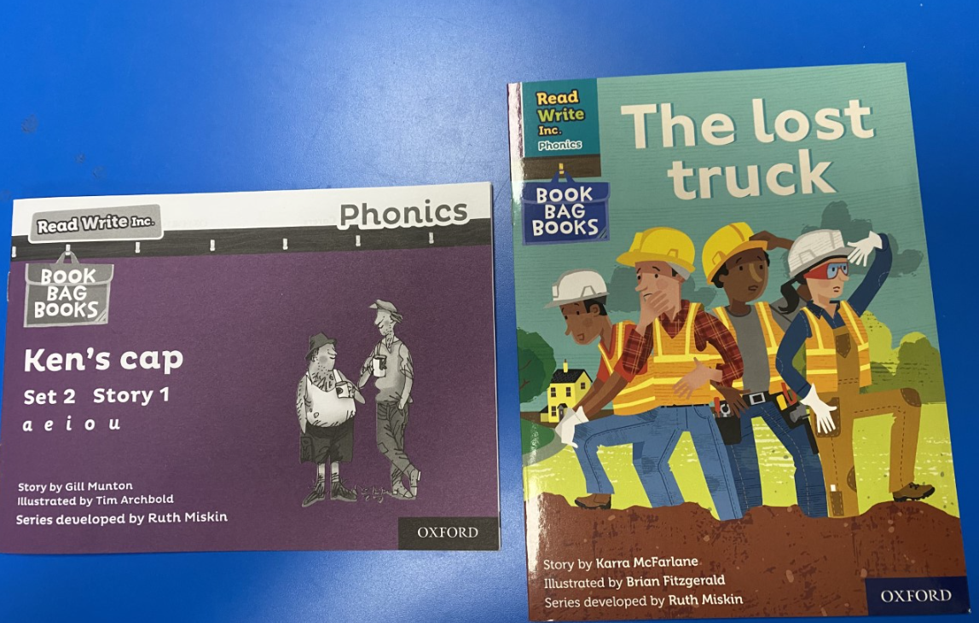
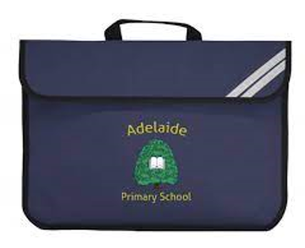
Your child will bring home 2 reading books

Slide 4
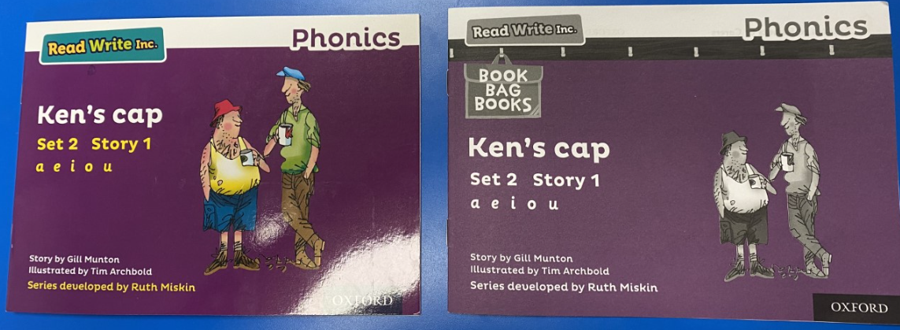
One of the reading books is the same book that your child will read in class.

Slide 5
Book Bag Books
Extra reading practice at home
Uniquely matched to the Read Write Inc. Phonics Storybooks.
Reinforce children's learning of phonics at the appropriate level.
Helps to make even faster progress in reading.
Notes:
We use Book Bag Books especially for home reading. They have guidance inside just for you as parents.
They are matched to the books children read in school so provide practice of the same sounds – extra practice at the right level for your child.
They include many of the same reading activities that we use in class.

Slide 6
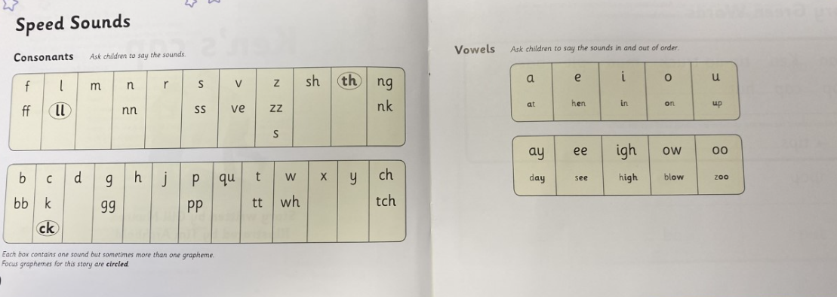
Speed Sounds
The sounds that are circled and in bold are the focus sounds.
Your child should know all of the sounds.
Adult can point to each sound and your child say the sound.

Slide 7
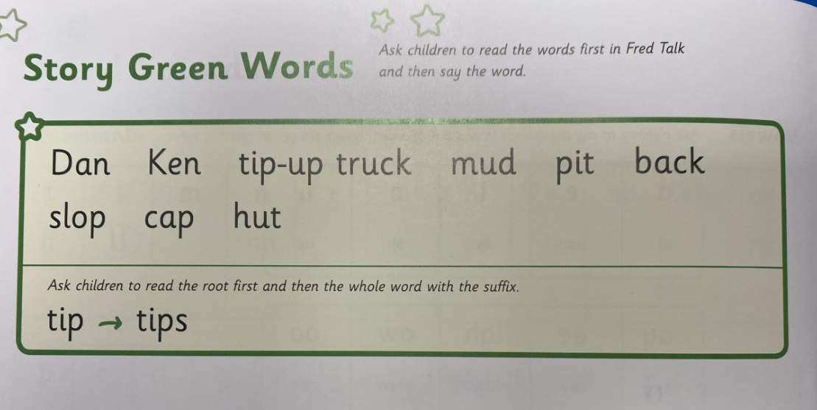
Story Green Words
These words appear in the book. Help your child read these words but try not to tell them the word.

Slide 8
‘Special Friends’, ‘Fred Talk’, Read the word
Special Friends
2 or 3 letters that make 1 sound
sh ay oo igh
2. Fred Talk
Sound out each phoneme
sh i p
This is how we teach your child to read at school.
3. Read the word
Read the whole word

Slide 9
‘Special Friends’, ‘Fred Talk’, read the word
Special Friends
2 or 3 letters that make 1 sound
sh ay oo igh
2. Fred Talk
Sound out each phoneme
sh i p
3. Read the word
Read the whole word

Slide 10
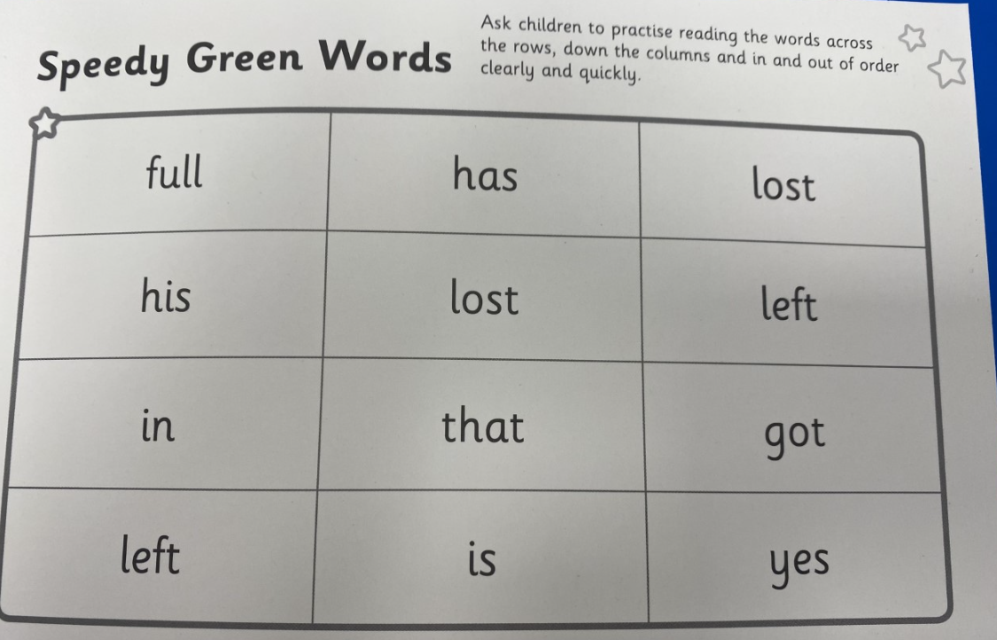
Speedy Green Words
These speedy green words are at the back of the book and your child should be able to read these words fast ‘speedily’.
Adult could point to the words and your child reads.

Slide 11
Red Words
The red words are tricky words. These words cannot be sounded out using phonics. Your child just needs to remember these words. These words appear in the book in red writing. If your child gets stuck on these red words in the book you can just tell them.

Slide 12
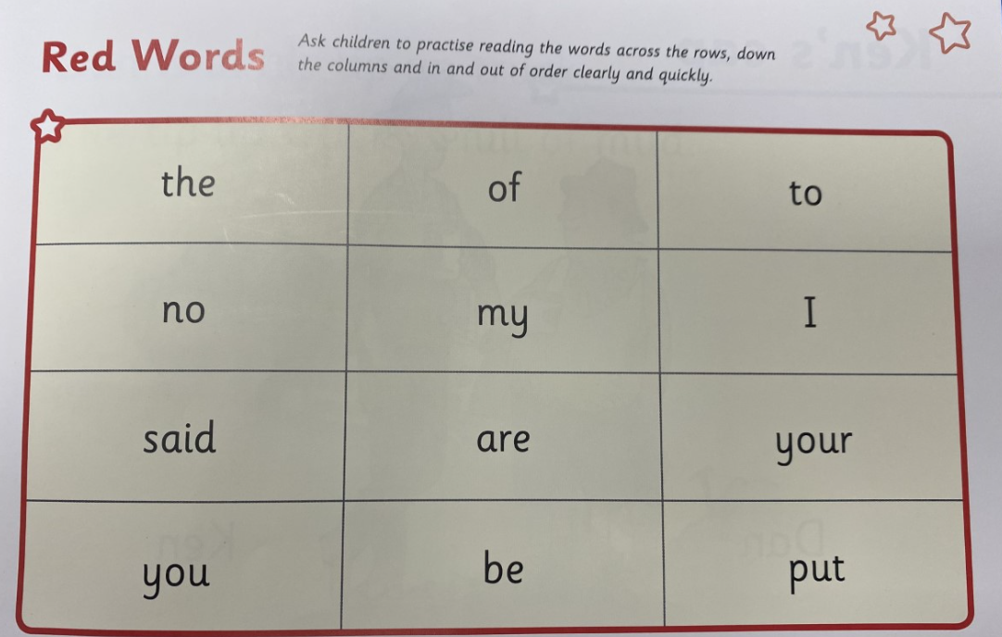
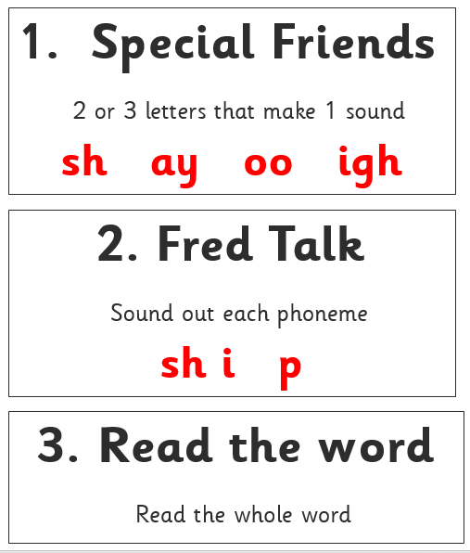
Red Words

Slide 13
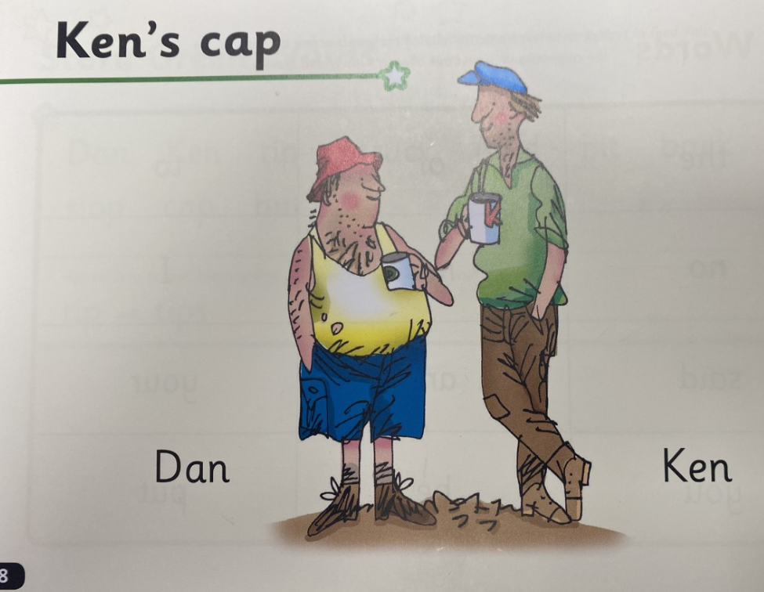
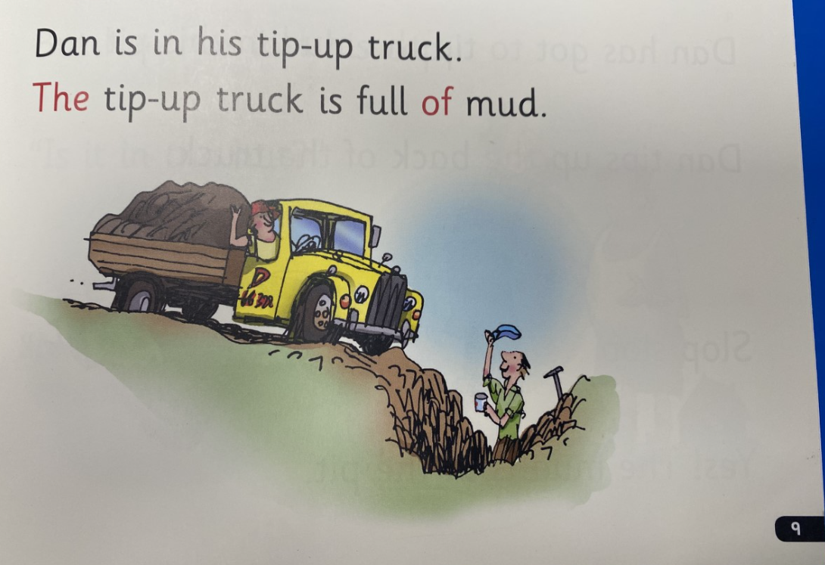
Listen to your child read each page.
If your child gets stuck on a word, do not tell them the word (unless it is a red word. Red words will be in red). Ask them to spot any special friends and to Fred talk the word.

Slide 14
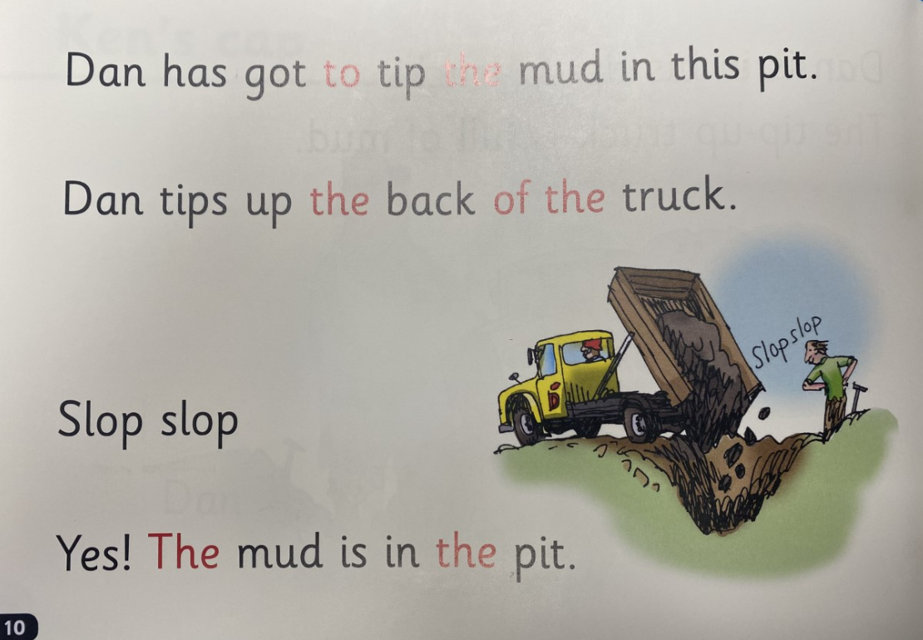

Slide 15
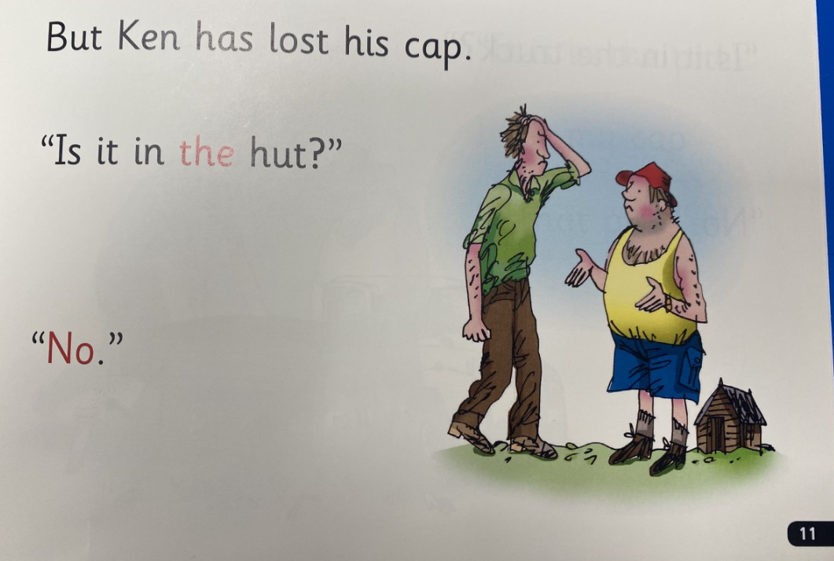

Slide 16
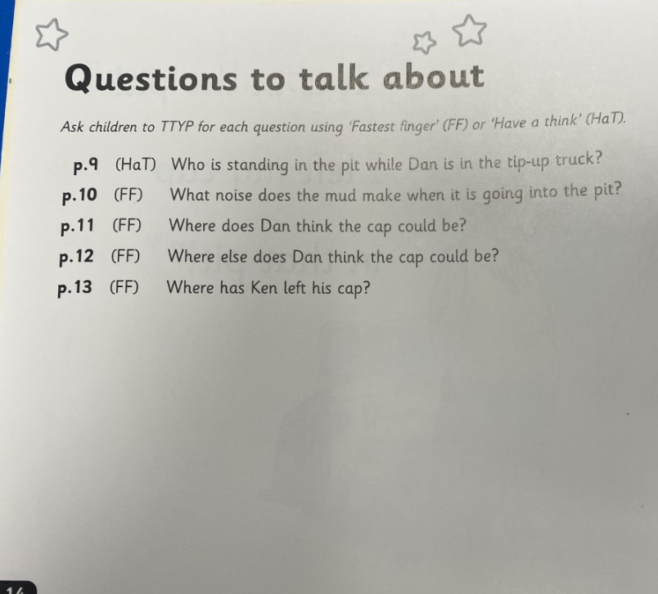
Question to help support comprehension skills
Each book has some questions for you to ask your child. These questions will be at the back of the book.
It tell you which page numbers the answers will be on.
Page numbers to find the answers on

Slide 17
Please look after the reading books!
Books should be kept in your child’s book bag everyday. Children will change books on different days.
There is a charge of £4 per book for any books lost or not returned in a good condition.

Slide 18
What can you do?
Listen to your child read the same Storybook again and again
Encourage them to use ’Special Friends’, ‘Fred Talk’, ‘read the word’
Discuss the story and encourage their storyteller voice.

Slide 19
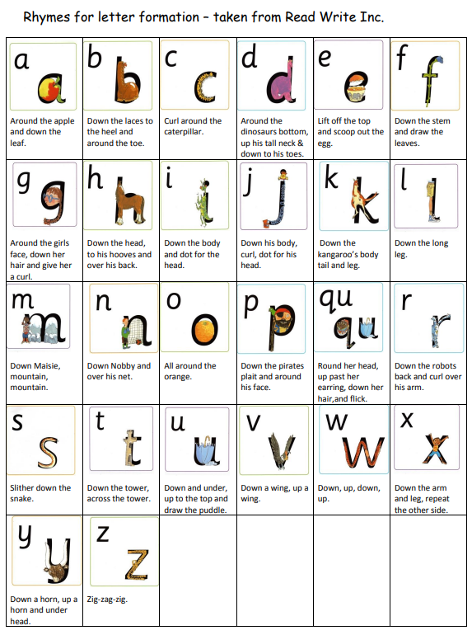
Handouts for you to take – Rhymes

Slide 20
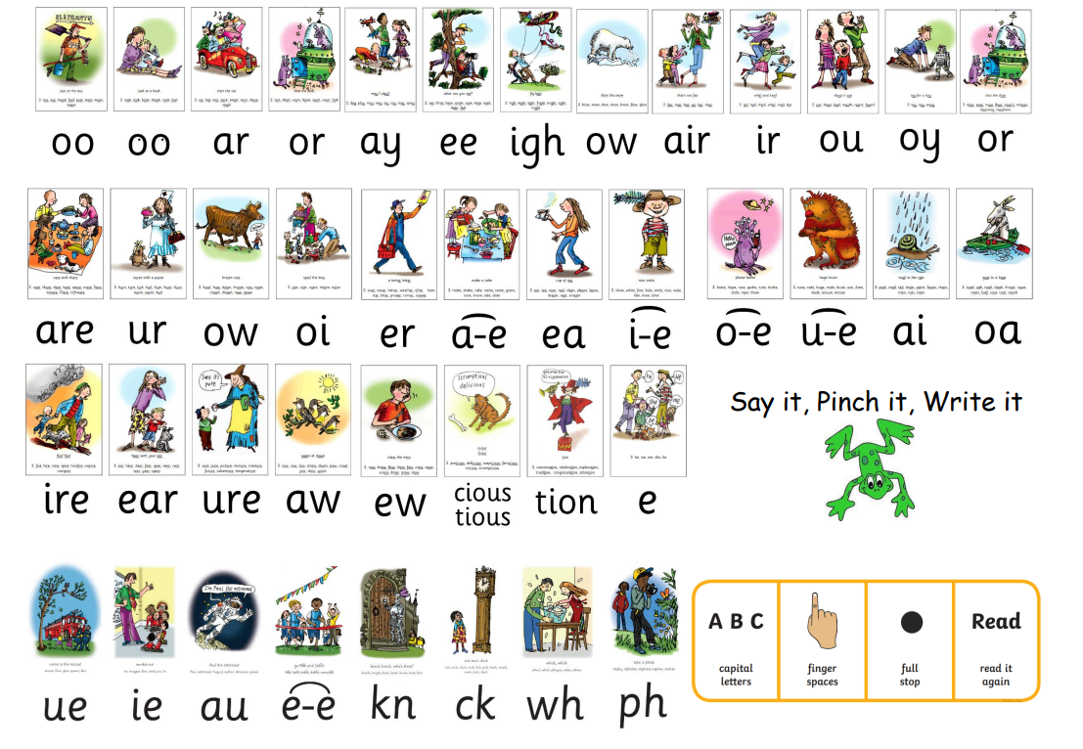
Handouts for you to take - Phonics Sound mat

Slide 21
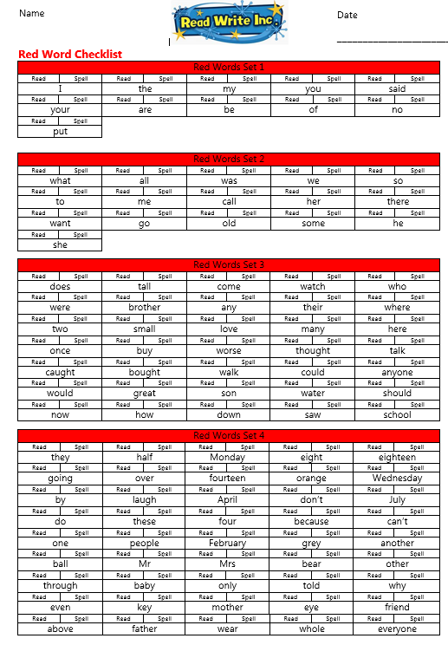
Handouts for you to take – Red Words Checklist

Slide 22
Online resources available
Ruth Miskin Parents’ Page:
http://www.ruthmiskin.com/en/parents/
Free e-books for home reading:
http://www.oxfordowl.co.uk/Reading/
Ruth Miskin Facebook:
https://www.facebook.com/miskin.education

Slide 23
The more that you read, the more things you will know. The more that you learn, the more places you’ll go!
Dr. Seuss
Notes:
In the words of Dr Seuss…read quote.
Good readers do well in school – and in life.
By listening to your child read, you are making sure they have the opportunity to practise and become a good reader quickly.
Remember that all parents have the power to change outcomes for their children.

Slide 24
Any other questions
Q&A

